Slide 1
Capacity

Slide 2
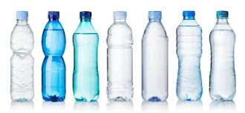
What is capacity?
Capacity is the amount of liquid a container can hold.
When we are talking about capacity, we are talking about a liquid
Liquid is measured in Litres (l) and millilitres (ml)

Slide 3
Litres and millilitres
Liquid is measured in litres and millilitres.
We use the symbol l for litres, and ml for millilitres
Litres (l) | Millilitres (ml)
1l 1.0l | 1,000ml
1/2l 0.5l | 500ml
1/4l 0.25l | 250ml
1/5 l 0.2l | 200ml
1/10l 0.1l | 100ml

Slide 4
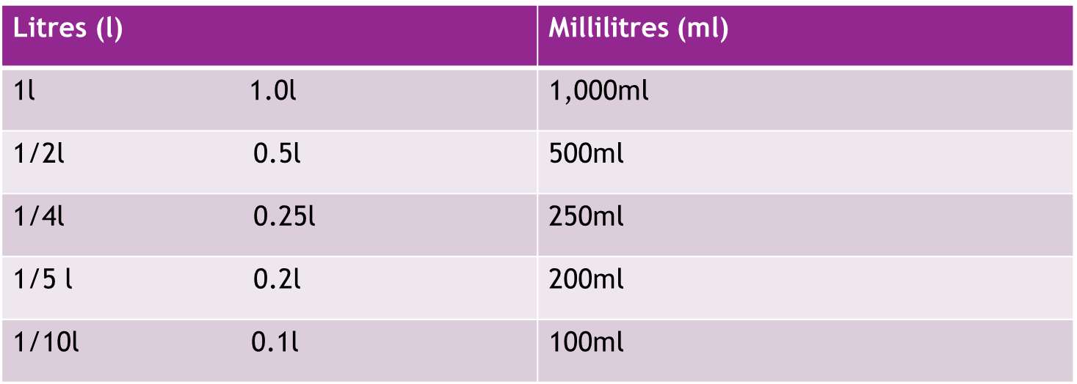
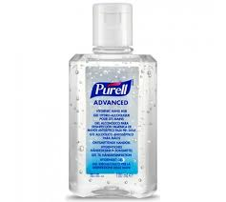
Litres and millilitres
500ml bottle = ½ l
100ml hand sanitiser = 1/10l

Slide 5
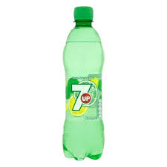
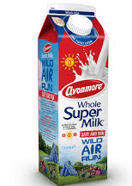
Examples of capacity
object | capacity
 | 1ml
 | 5ml
 | 50ml
 | 500ml
 | 1l

Slide 6
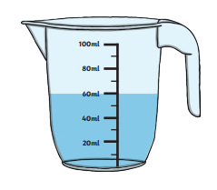
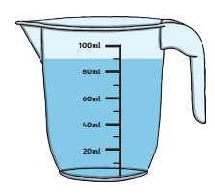
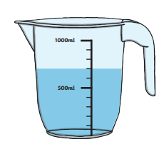
How much liquid is in the jug?
____________ml
____________ml

Slide 7
Best of luck with your
work this week!

