Slide 1
3D shapes

Slide 2
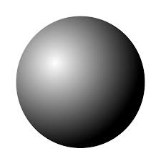
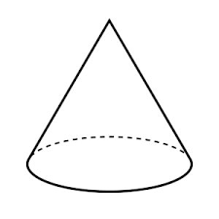
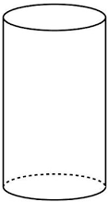
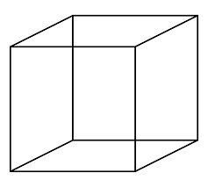
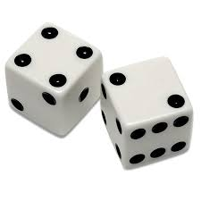
3D shapes
A 3D shape is one that takes up space.
They have a length, width, and height
sphere
cone
cylinder
cube
cuboid
Notes:
You can pick them up – boxes, cans of pringles, etc. a 2D shape cannot be picked up or felt – they only have a length and width.

Slide 3
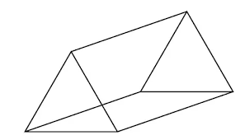
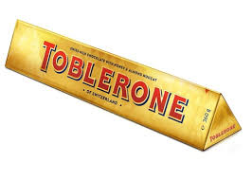
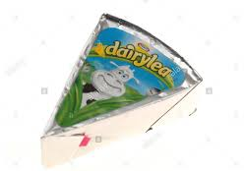
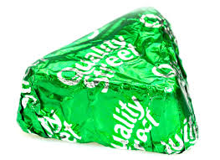
Triangular prism
A triangular prism has a triangle at each end, and the other sides are rectangles.

Slide 4
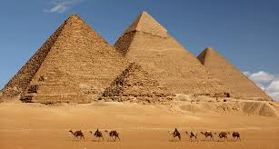
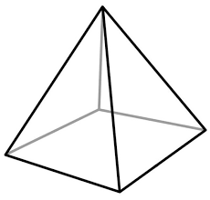
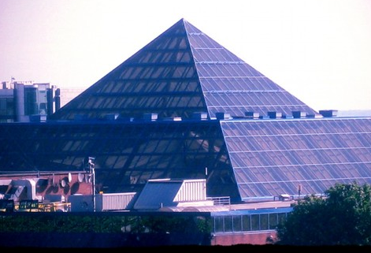
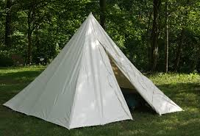
pyramid
A pyramid is a shape that usually has a square on the bottom, and its other sides are made up of triangles that make a point at the top
Notes:
Can have a triangle on the bottom too, or other shapes, but a square is most common! Eygpt, tent, the square!

Slide 5
Parts of a 3D shape
Every 3D shape is made of different parts! Every 3D shape has at least 1 face, and most of them have edges and vertices.

Slide 6
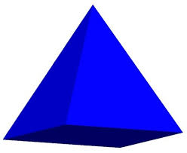
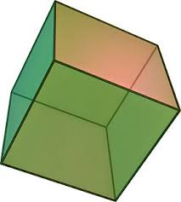
Faces
A face is a surface of a shape
They are made of 2D shapes

Slide 7
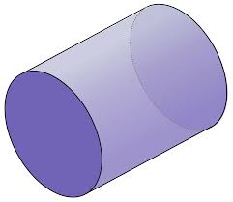
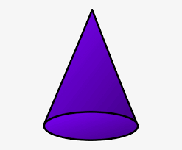
Spheres, cylinders, and cones have faces that are a bit different.
These shapes have a curved face
Notes:
These shapes can roll because the have a curved face

Slide 8
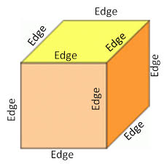
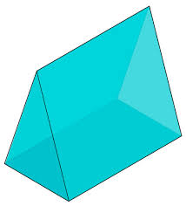
edges
An edge is a line that is made when two faces of a shape meet

Slide 9
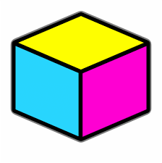
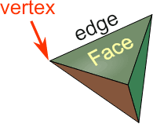
Vertex
A vertex is another word for a corner.
A vertex is seen when two edges meet and make a point
Vertices is the plural

Slide 10
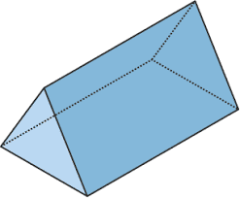
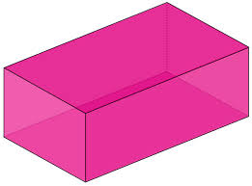
Let’s try it!
Look at these shapes, and try to see how many faces, edges and vertices they have
6 Faces
12 edges
8 vertices
5 faces
9 edges
6 vertices

